Slide 1
BFO: 2025 C-FORS Exercises

Slide 2
Case 1
In aircraft_data.xlsx you will find a row for the Airbus A320 Neo.
Construct a BFO-conformant design pattern reflecting the content of columns C-G, R-S, and AB.

Slide 3
Case 2
In aircraft_data.xlsx you will find a row for the Airbus A321-111, designed to have a maximum knot approach speed of 142. However, after 5 approaches, an instance has obtained an average maximum knot approach speed of 139.
Construct a BFO-conformant design pattern reflecting the preceding phenomena.

Slide 4
Case 3
In soc_structure_definitions.xlsx you will find three “SOC_TITLE” entries that mention “Aerospace Engineer”.
Construct a BFO-conformant design pattern that reflects all three entries and their respective “SOC Definitions”.

Slide 5
Case 4
In employment_wage_May_2024.xlsx you will find three “OCC_TITLE” entries that mention “Aerospace Engineer”.
Construct a BFO-conformant design pattern that reflects all three entries and their associated columns A, H, I, K, L.

Slide 6
CLOSING REMARKS

Slide 7

UB Applied Ontology
In Fall 2025, UB will enroll the first class of applied ontology PhD and MS students
At present count, we have an entering class of 20 PhDs and 15 MS students
The program is entirely remote and asynchronous

Slide 8
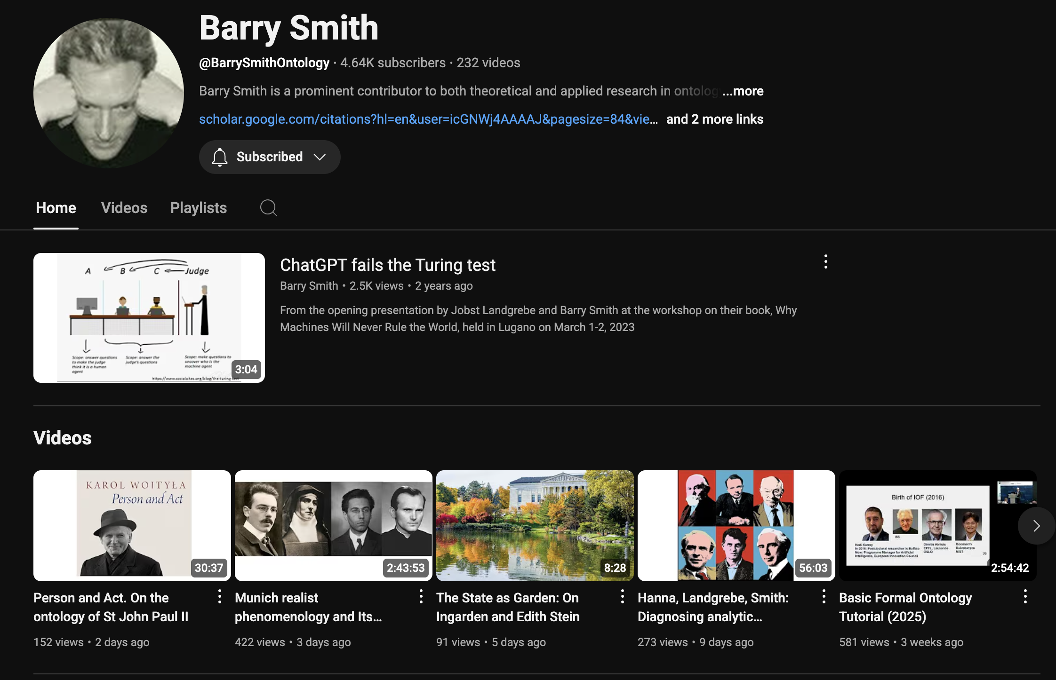
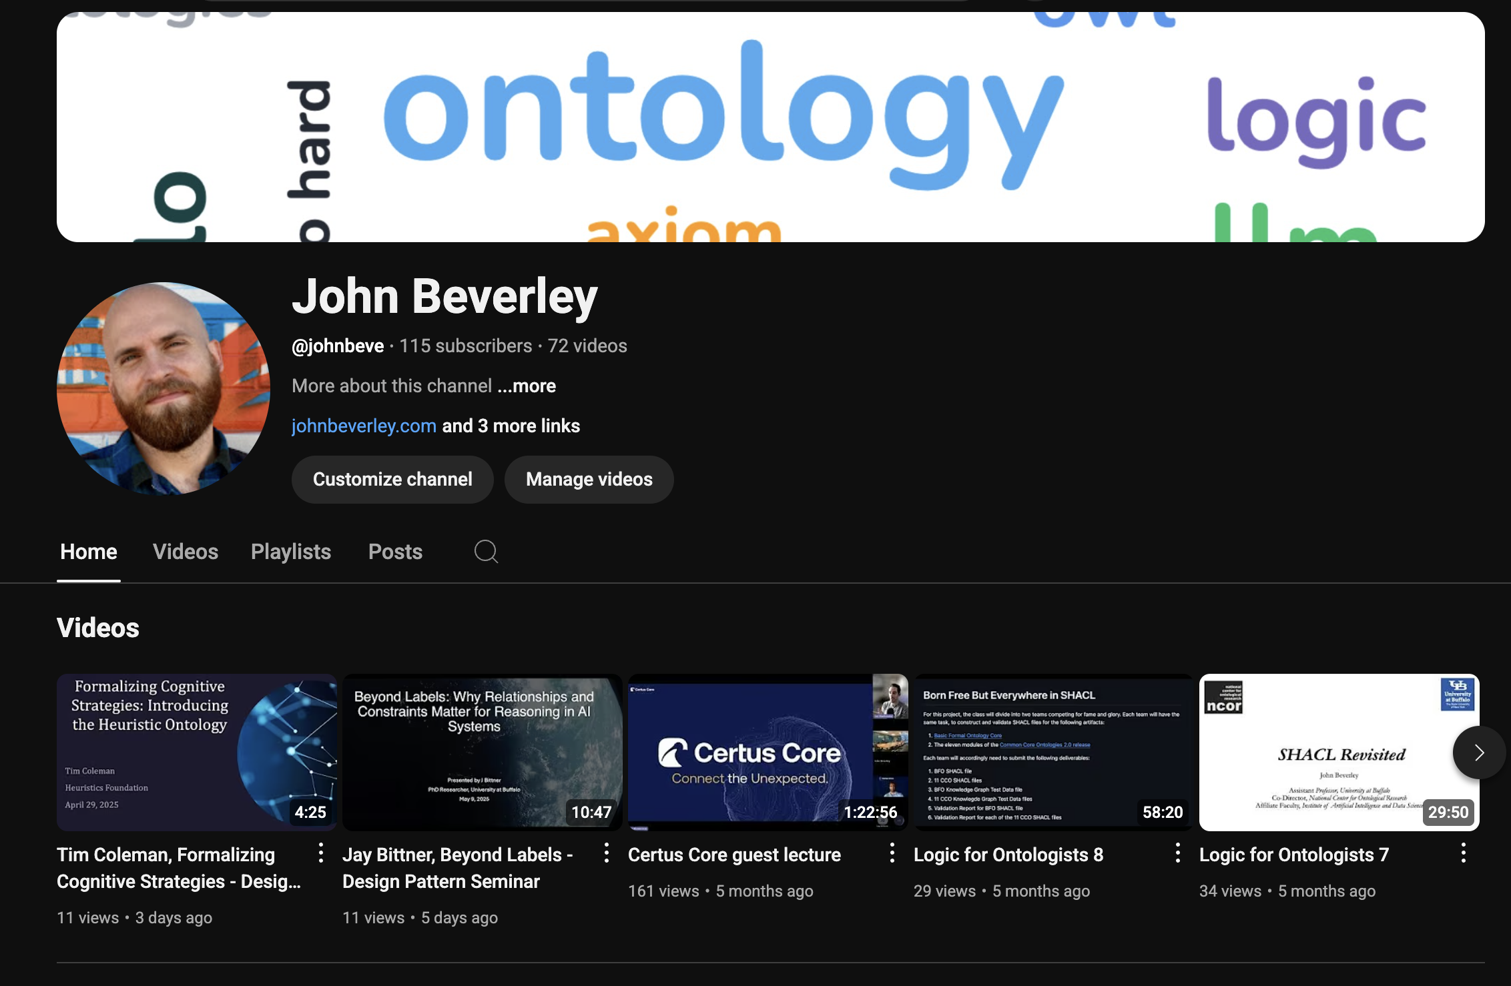
MIT Model
That said, all of our education material will remain accessible online: https://github.com/Applied-Ontology-Education

Slide 9


Slide 10
Community Effort
Fidelity (Knowledge Representation Group)
University of Michigan (Bioinformatics)
Florida State University (Information)
Johns Hopkins Applied Physics Lab
University of Virginia (Data Science)
Department of Homeland Security
Customs and Border Protection
Knowledge Graph Alliance
Syracuse University (CSE)
Air Force Research Labs
CUBRC
KadSci
George Mason University (C4l & Cyber)
Northwestern University (Philosophy)
University of Maryland (Physics)
Industrial Ontologies Foundry
Colgate University (Philosophy)
UB (Bioinformatics Department)
Ohio State University (Logic)
UB (CSE Department)
Bloomberg (HR)
Aerospace
Scania

Slide 11
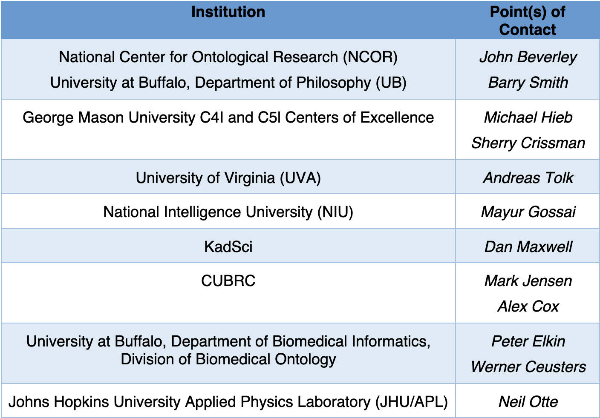
Community Effort
Create a training consortium
Whose members may:
Enter articulation agreements
Supervise new ontologists
Host tutorials, bootcamps, certificates, full programs, etc.
Provide internships
Disseminate training material and documentation for existing and future ontology training

